Slide 1

Simulation nonsense
Chris “butterfly boy” Halsch

Slide 2
Why simulation?
Great way to understand what a model is doing short of actually doing the math.
Great way to ensure that a model in functioning properly
Great way to gain understanding about processes we can not measure.
It’s fun?

Slide 3
Why simulation?
Great way to understand what a model is doing short of actually doing the math.
Great way to ensure that a model in functioning properly
Great way to gain understanding about processes we can not measure.
It’s fun?

Slide 4
Simulation in modeling
In real life we build models to represent relationships between variables of interest.
Butterflies and temperature
Butterflies and pesticides
Butterflies and plants
We have to do this because we cannot collect all the data in the world.
If the relationships we model are important, the model should give us understanding about data we did not collect.

Slide 5

Simulation in modeling
Garbage in, garbage out.
A bad model will run as well as a good model.
How can we know if the model we build is working properly?
How do we know if the model makes sense at all?

Slide 6
Simulation in modeling
We use simulation to build data like those we intend to collect.
We implement the model we intend to use.
That model should return the simulated “truth.”
If it does, great! This gives some confidence that the model is working as intended. That goes not mean it is good.
If the model does not return the “truth”, figure out why!

Slide 7

IMPORTANT NOTE
You need to run the model on the data you collect, you can not just simulate data to show what you want then publish it.

Slide 8
How do we do this?

Slide 9

How do we do this?

Slide 10
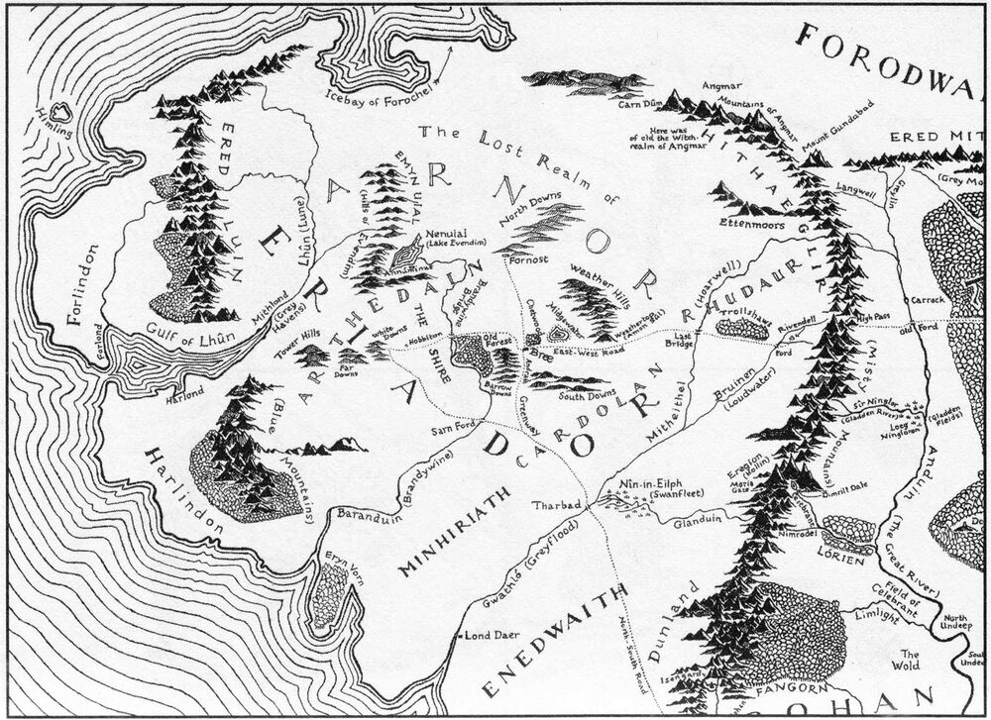
t-test

Slide 11
t-test

Slide 12
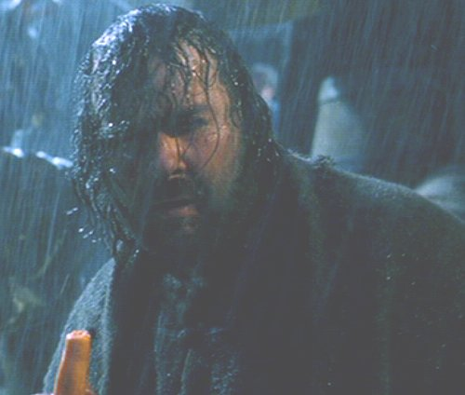
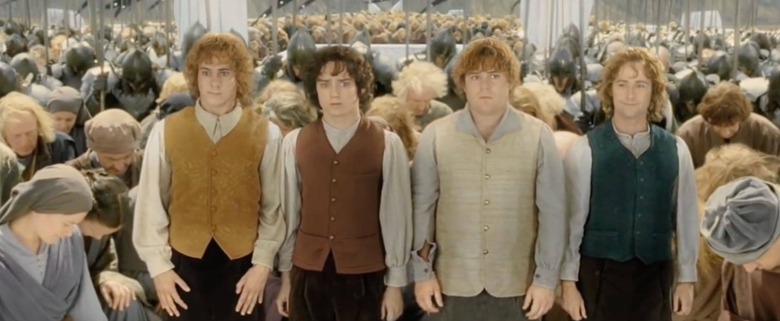
t-test

Slide 13
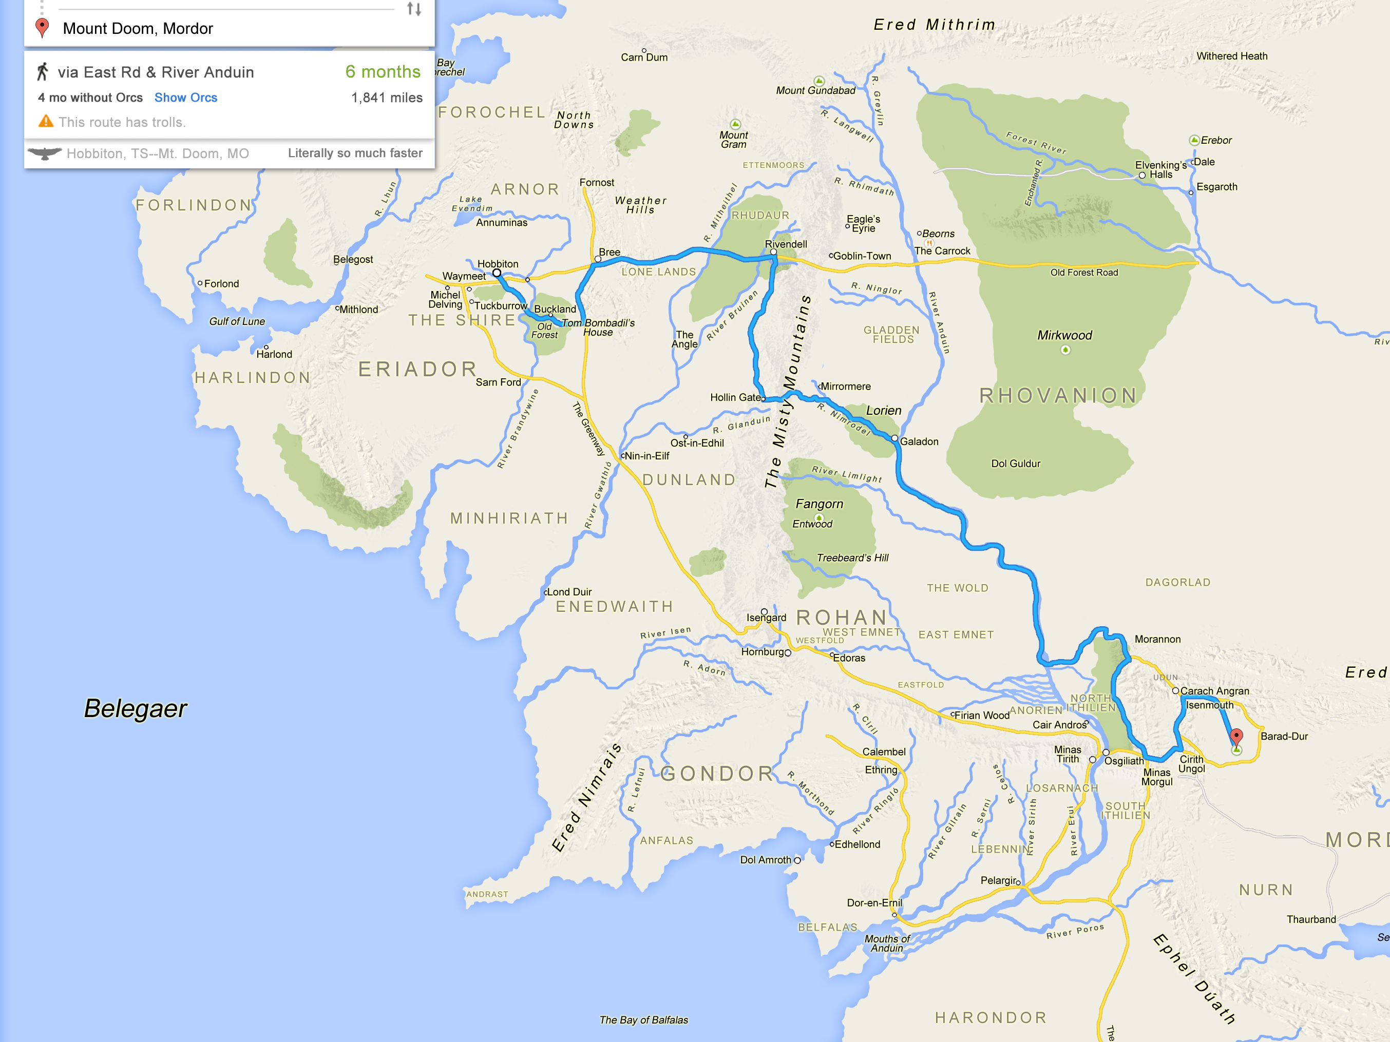
Regression

Slide 14
Regression

Slide 15
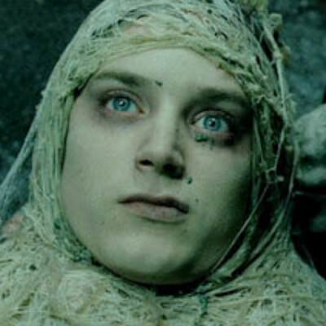
Regression

Slide 16
Regression

Slide 17
Regression

Slide 18
Regression

Slide 19
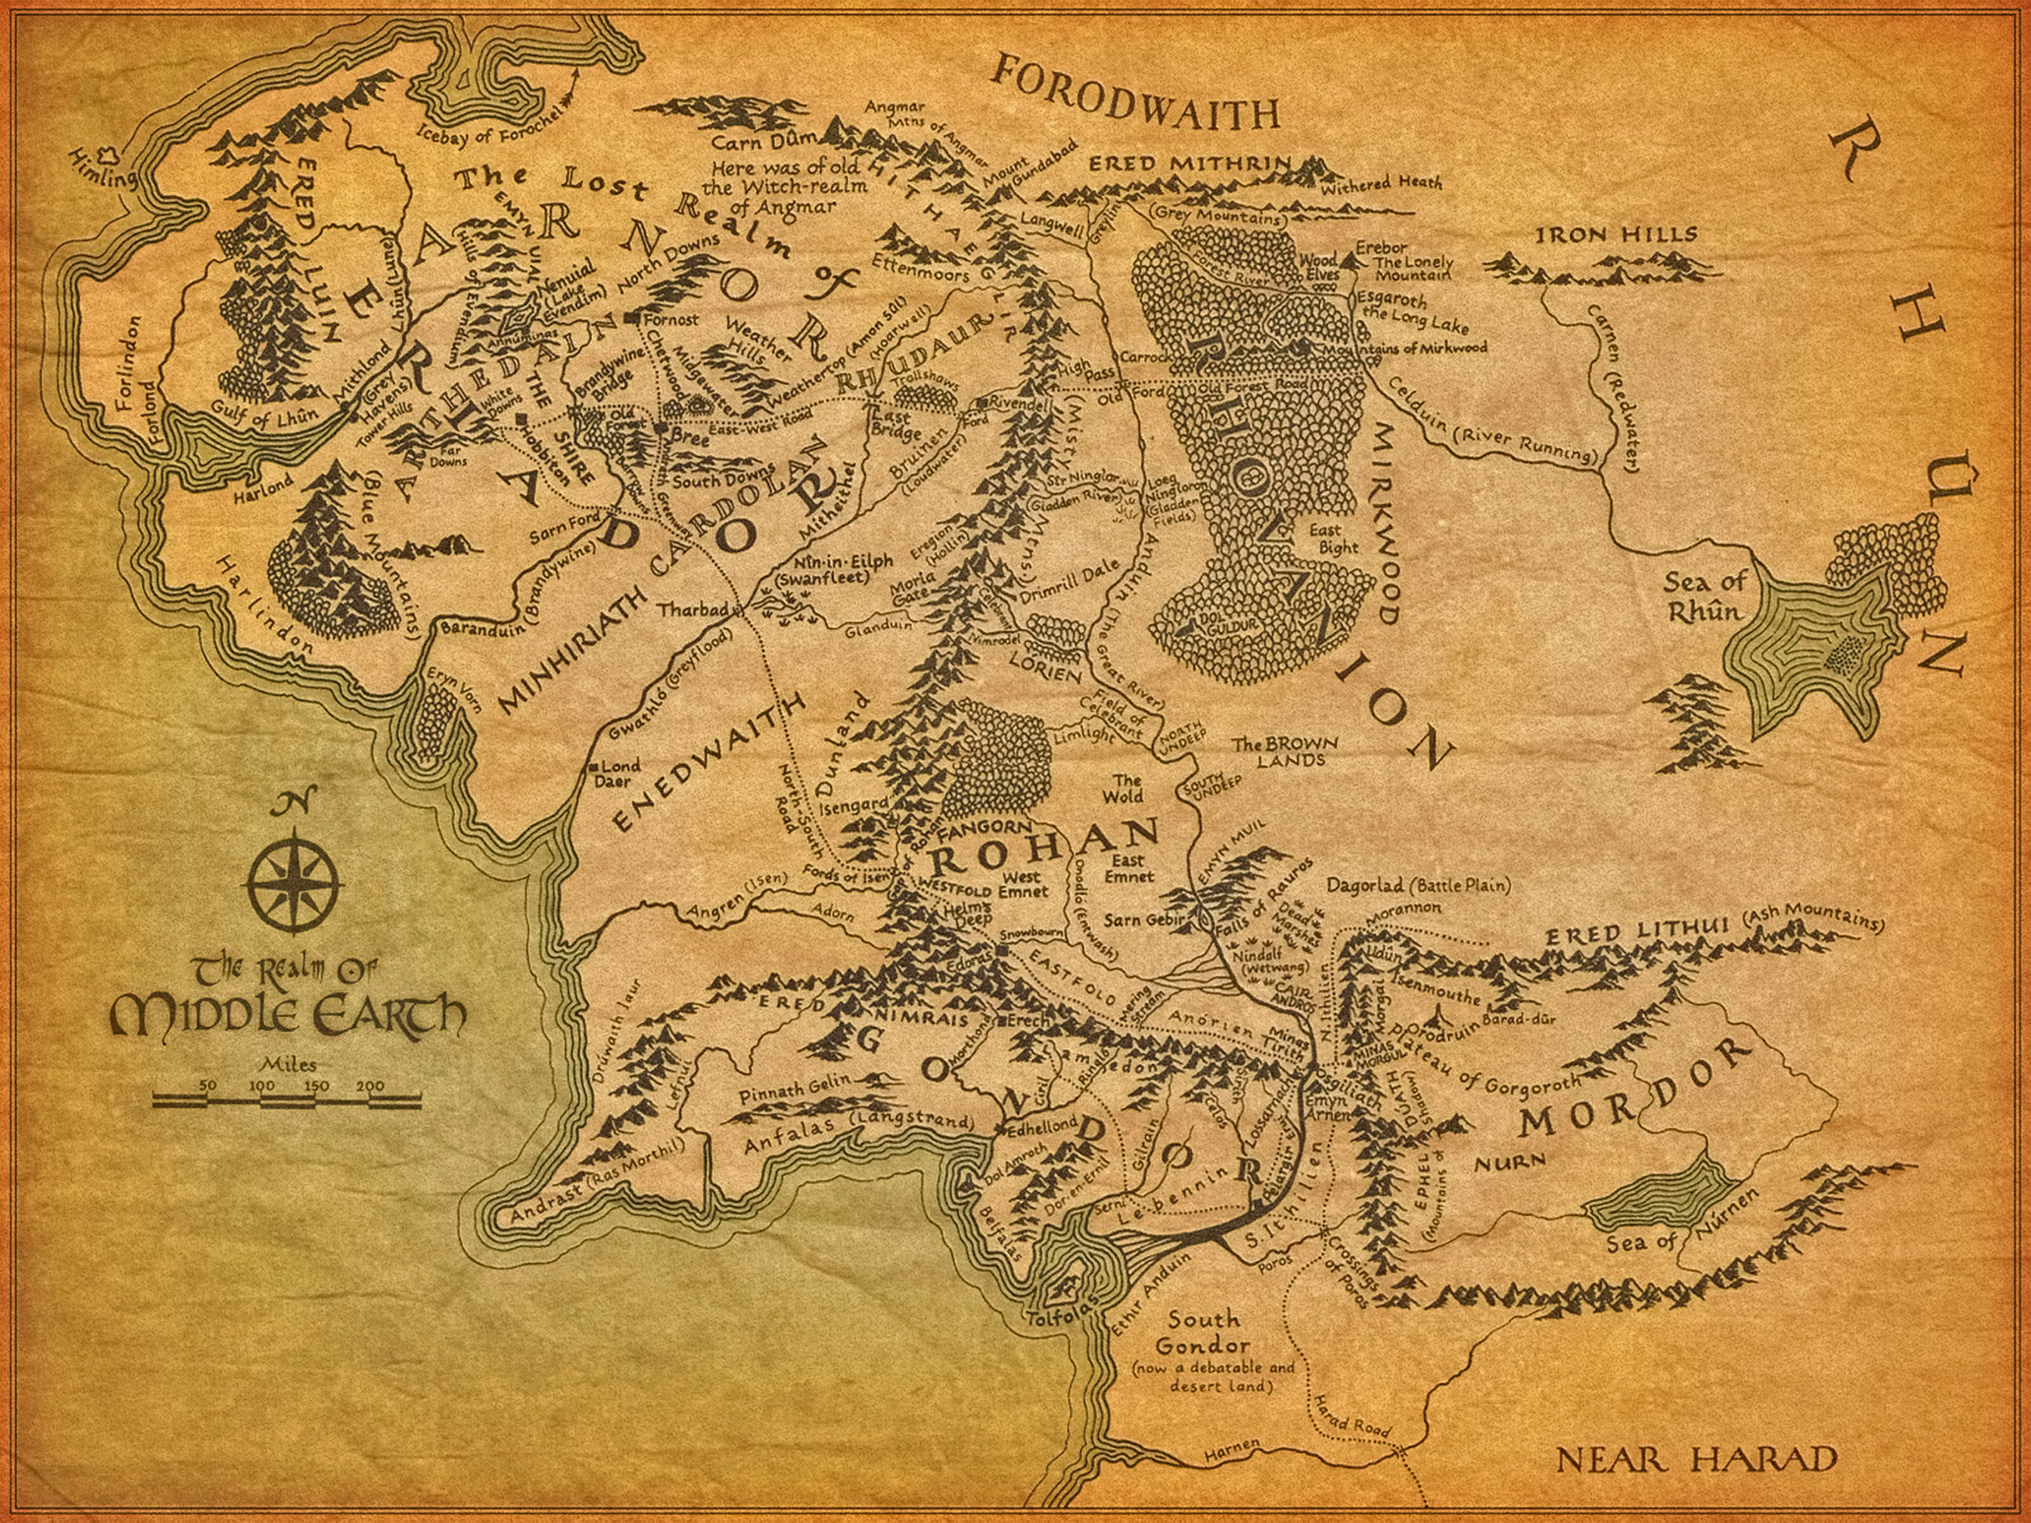
Mixed model

Slide 20
Mixed model

Slide 21

Mixed model

Slide 22
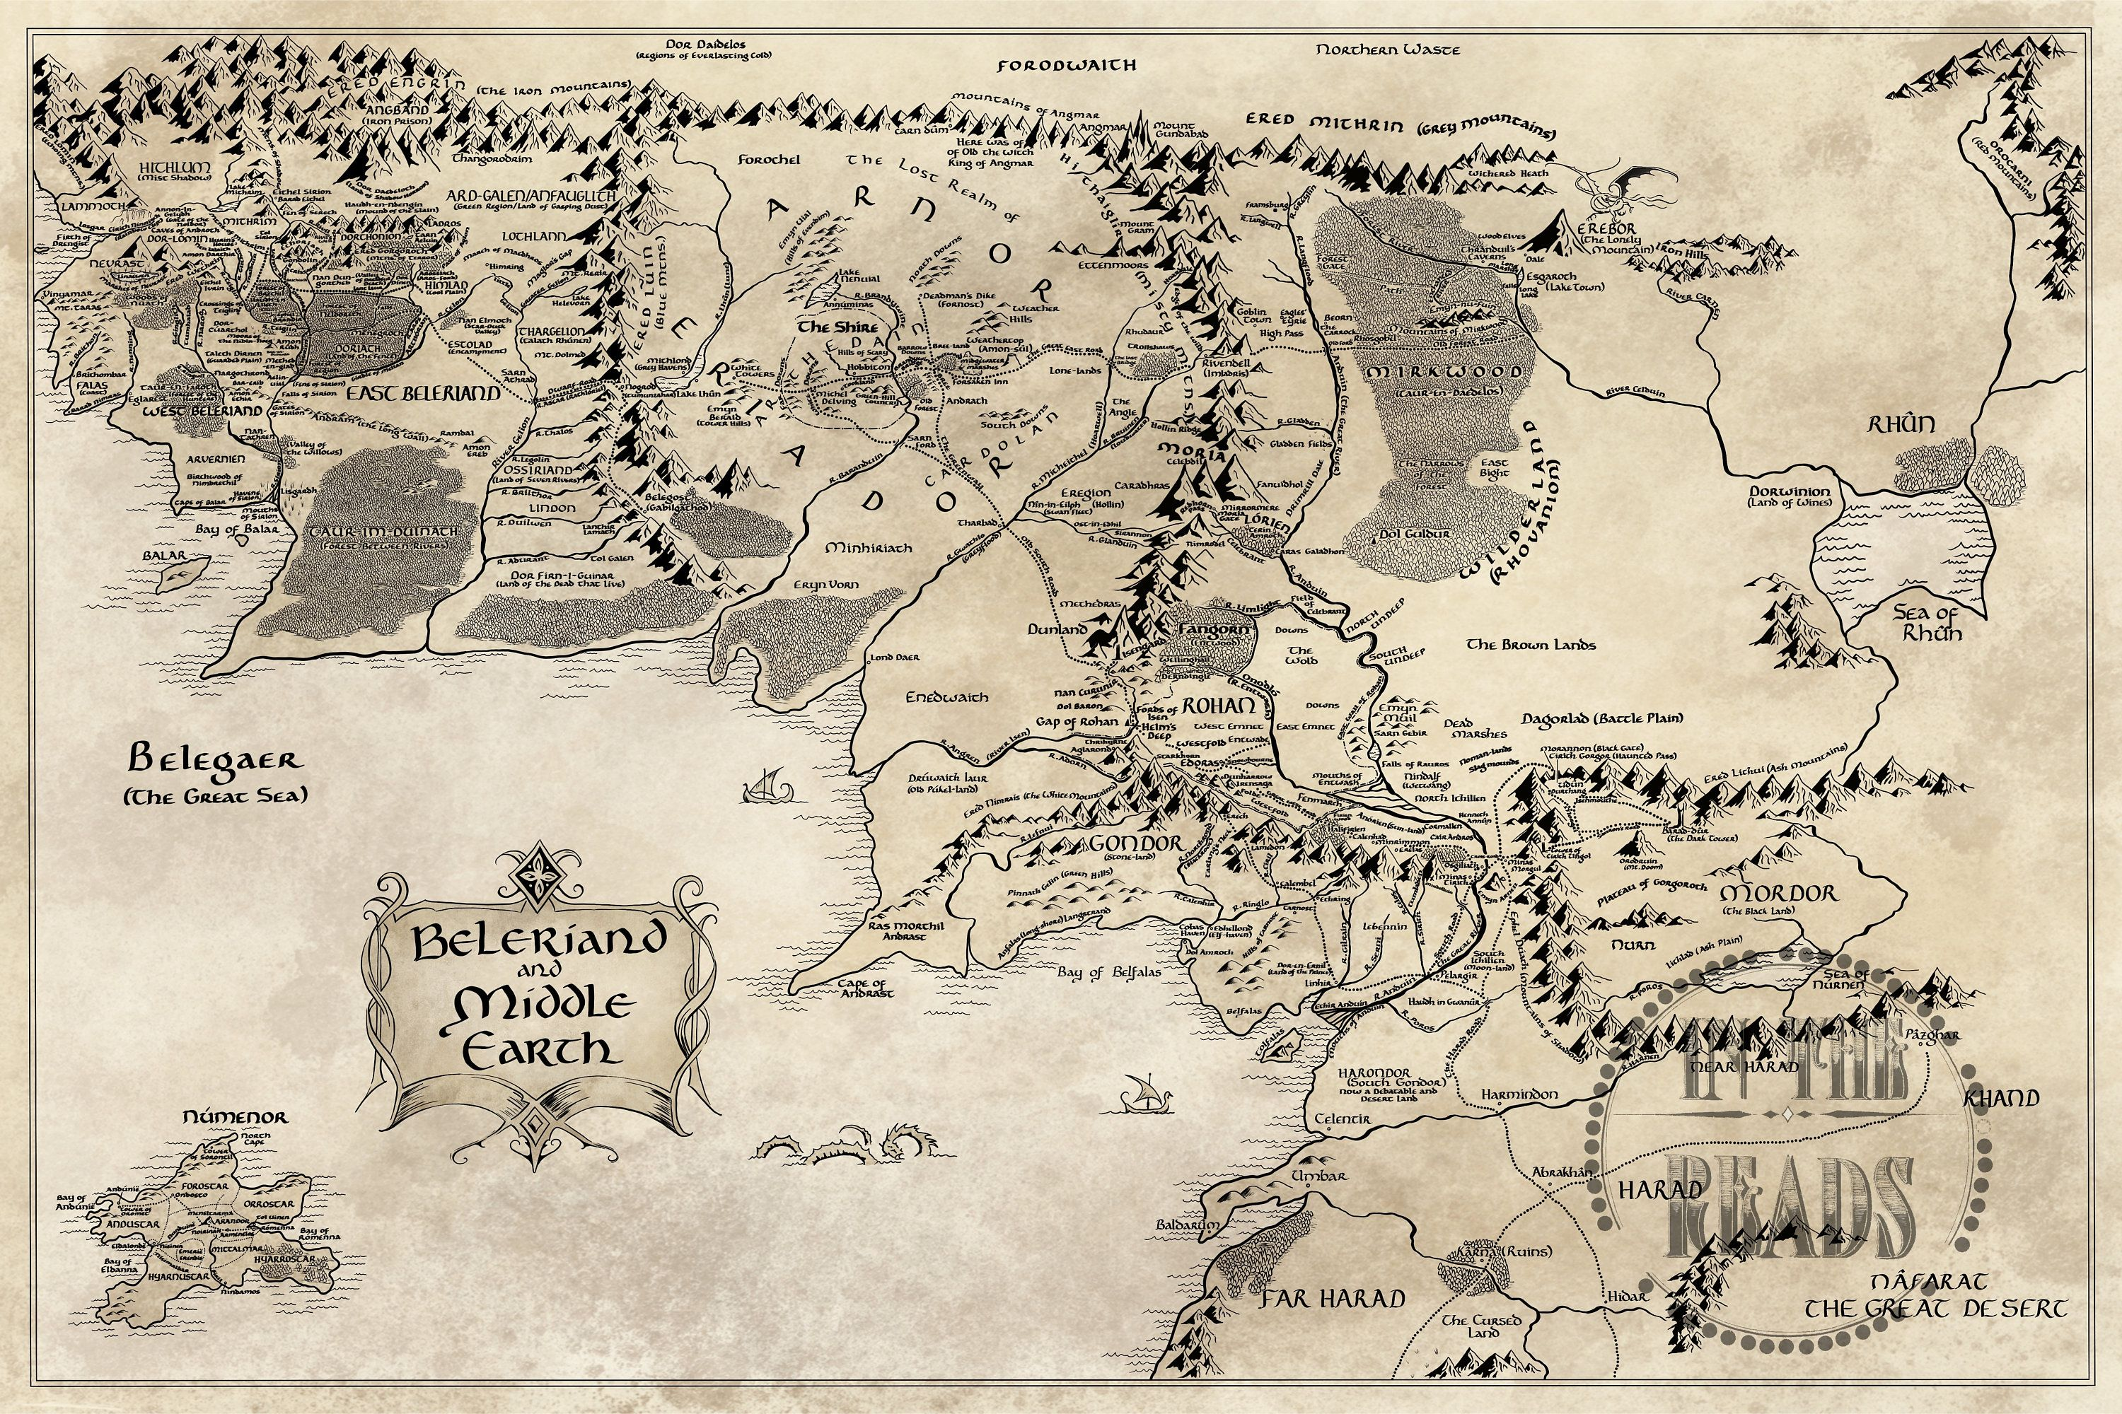
Binomial

Slide 23
Binomial

Slide 24
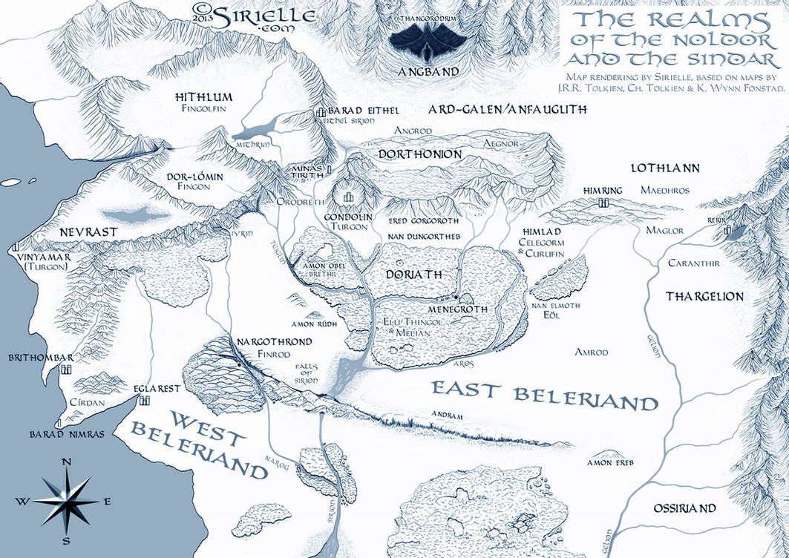
Binomial

Slide 25
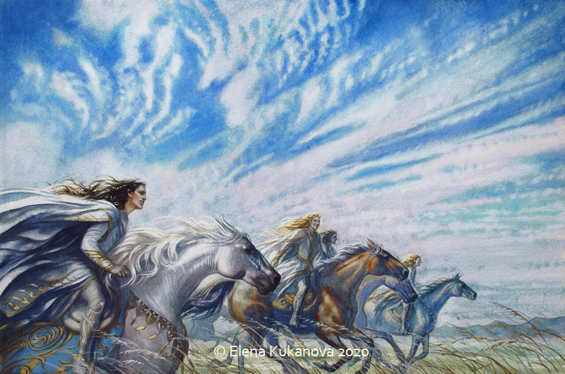
Binomial

Slide 26
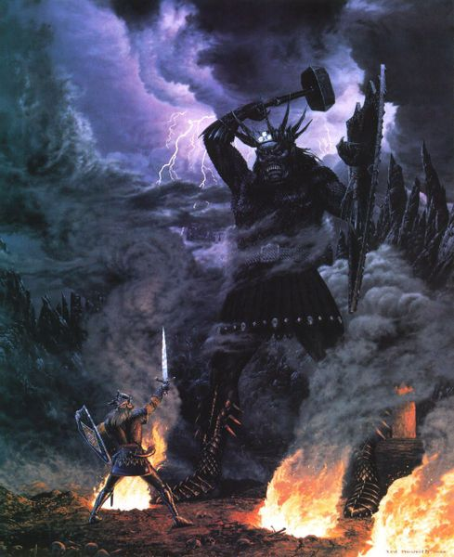
Binomial

Slide 27
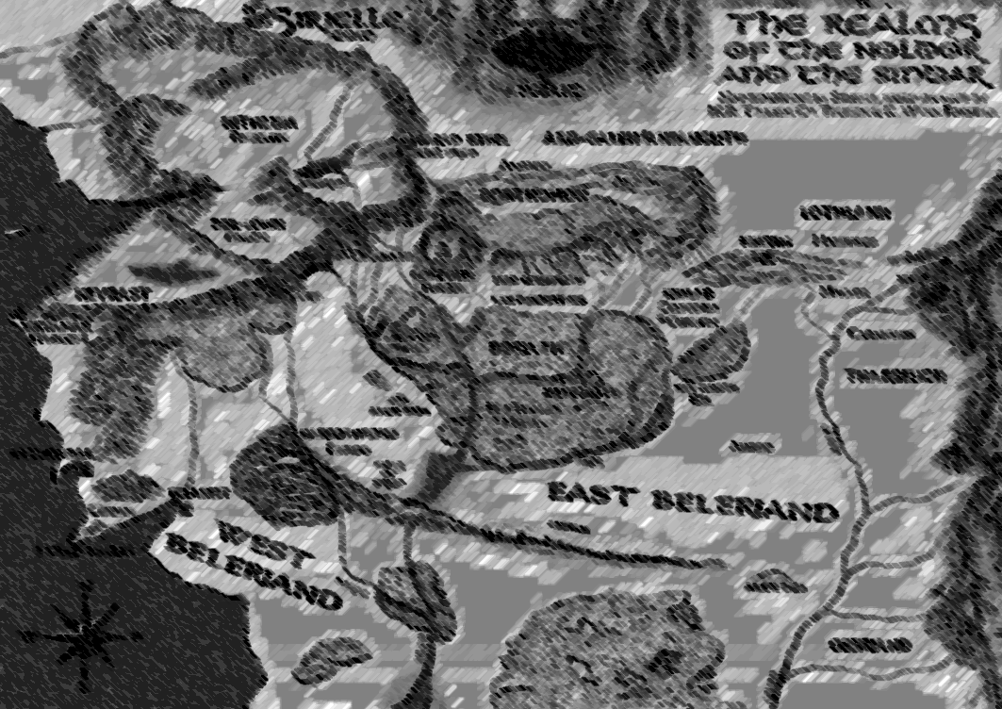
Binomial

Slide 28
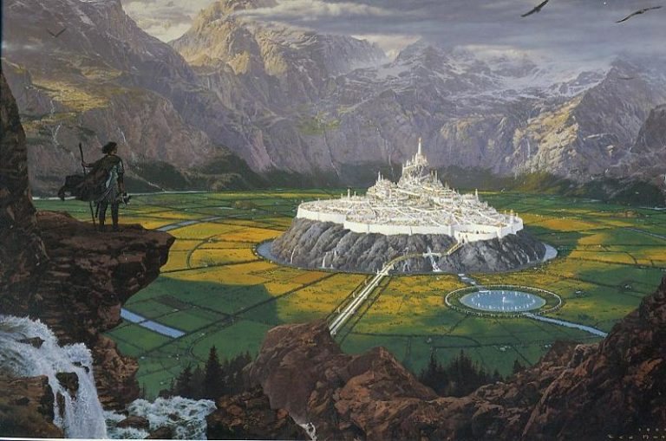
Binomial

Slide 29
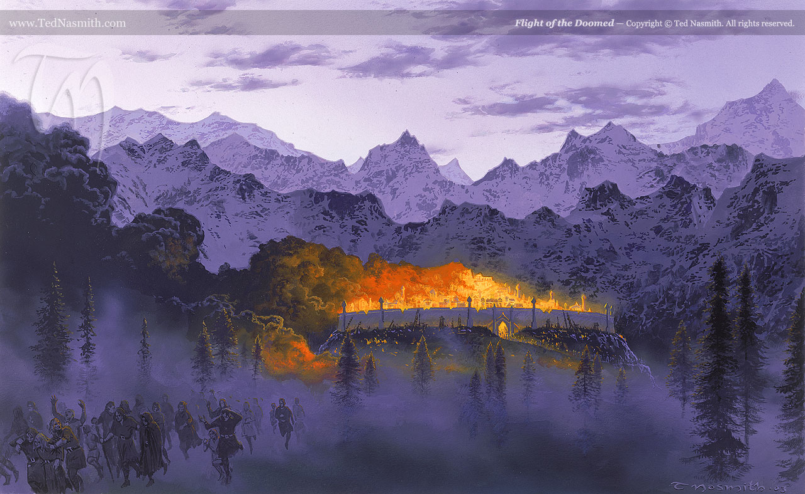
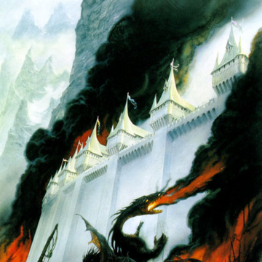

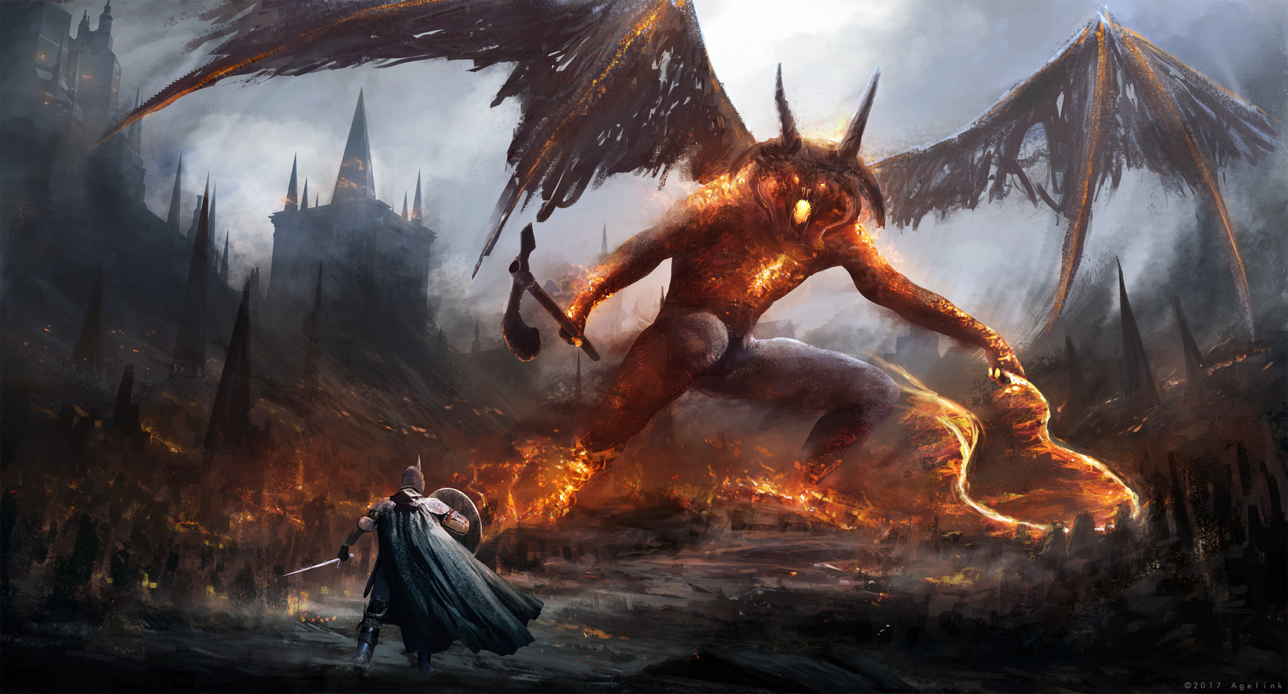
Fall of Gondolin

Slide 30
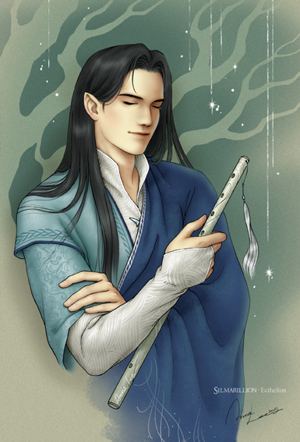
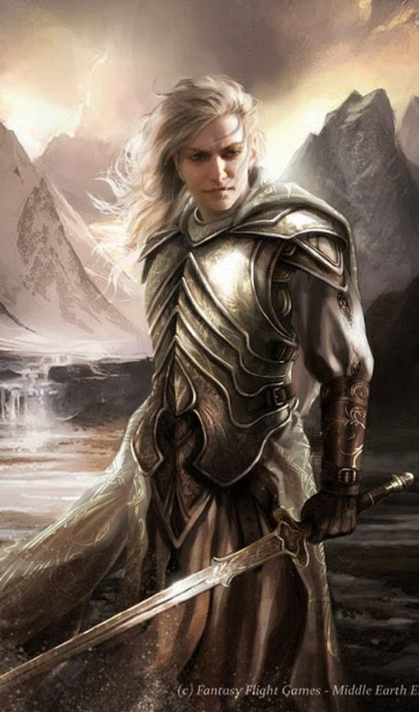
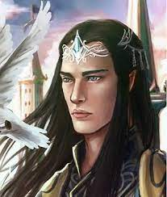
In memoriam

Slide 32
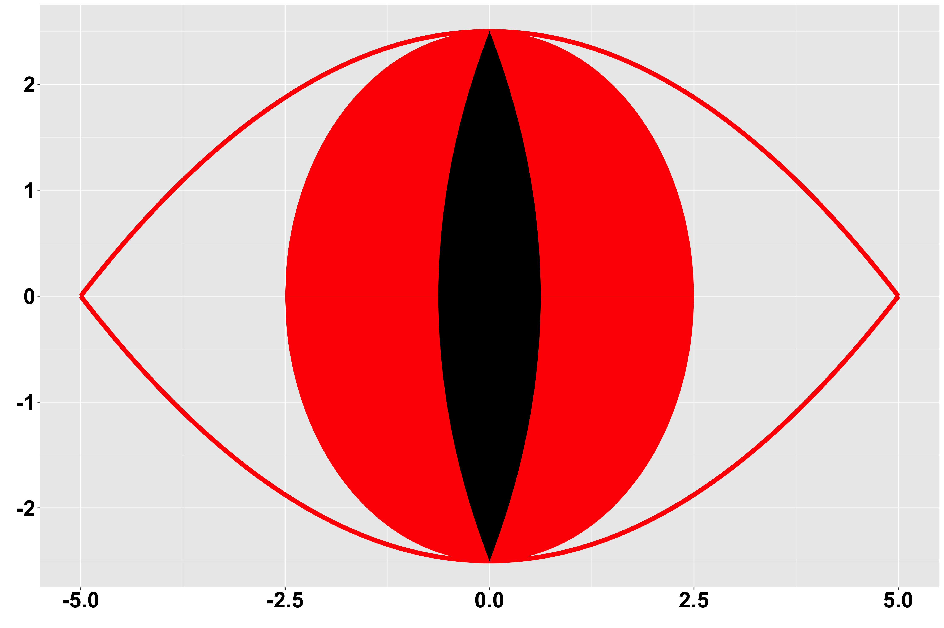

Slide 33
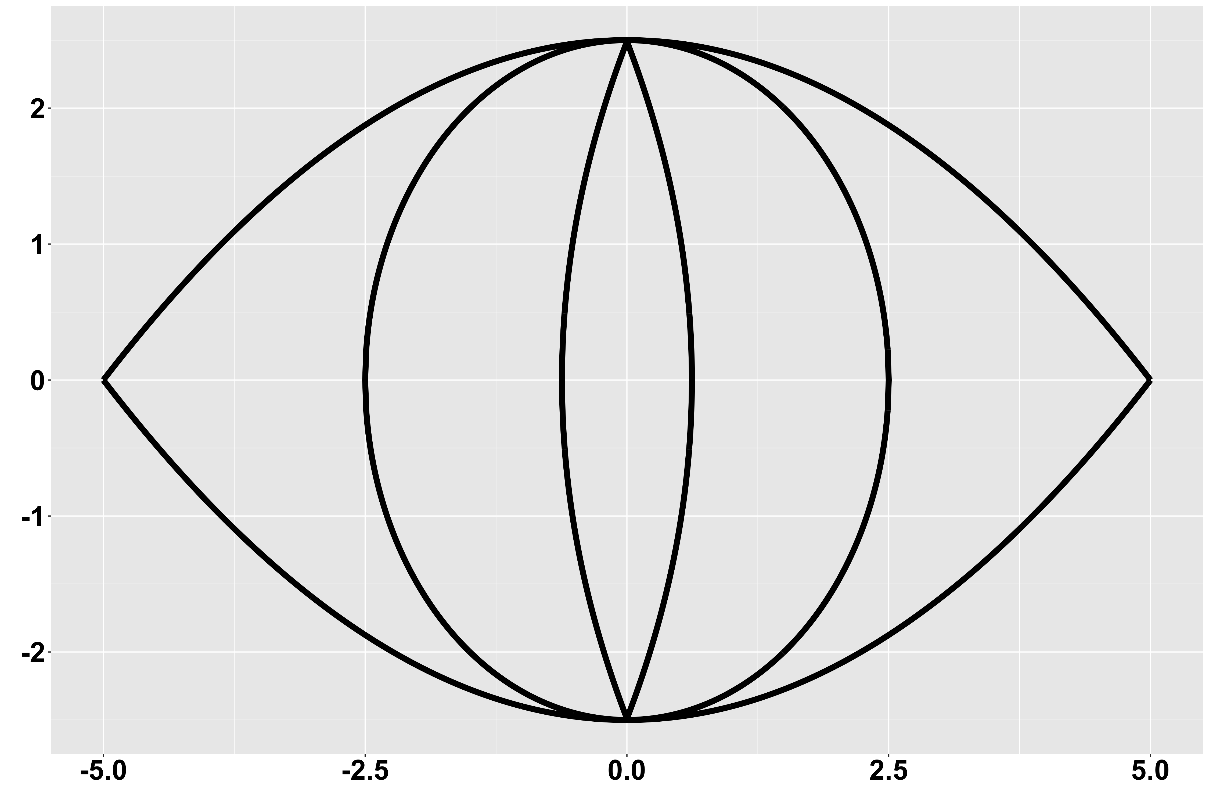

Slide 34
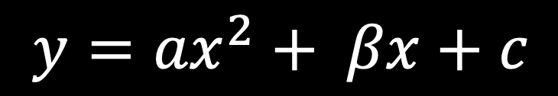

$$y={ax}^{2}+ βx+c$$

Slide 35
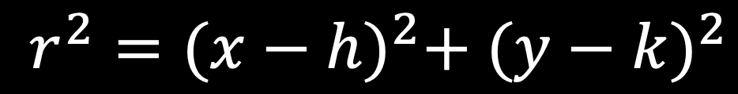

$$r^{2}={(x−h)}^{2}+ {(y−k)}^{2}$$

Slide 36
THANKS!

